Slide 1
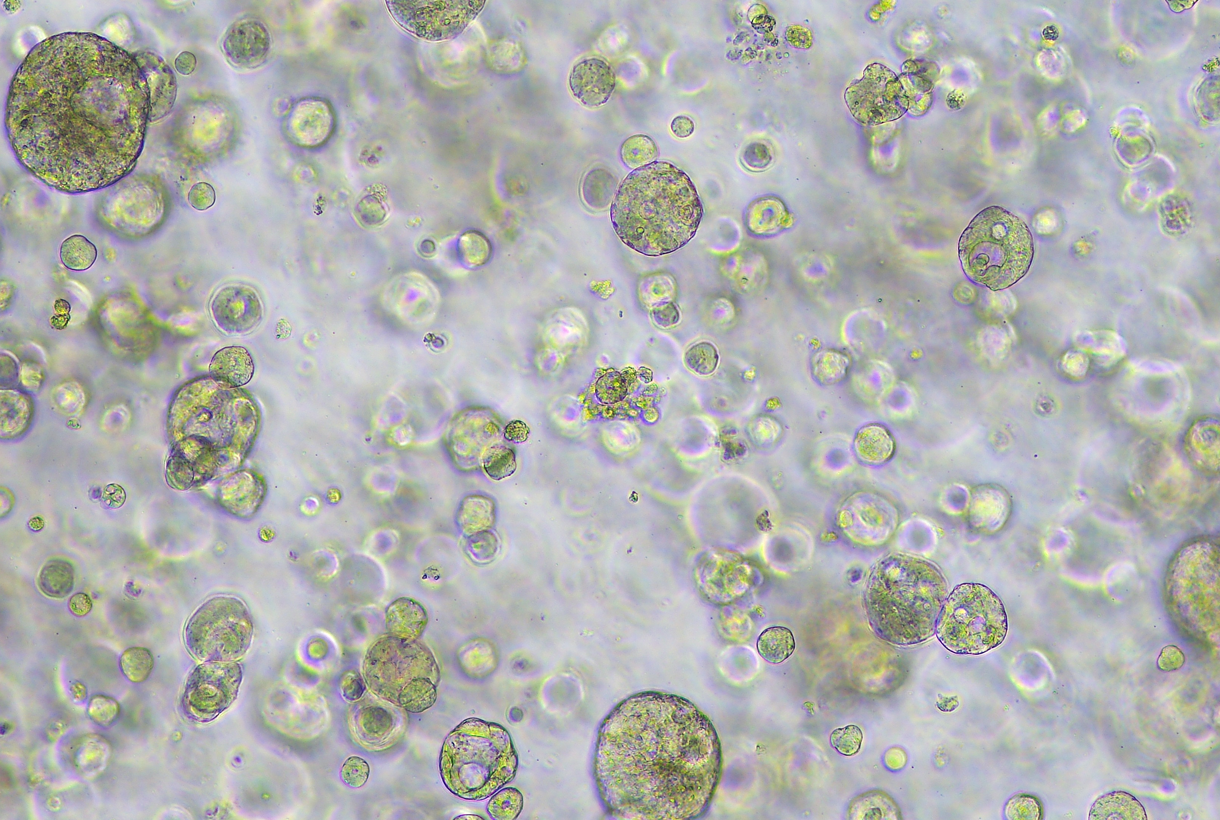
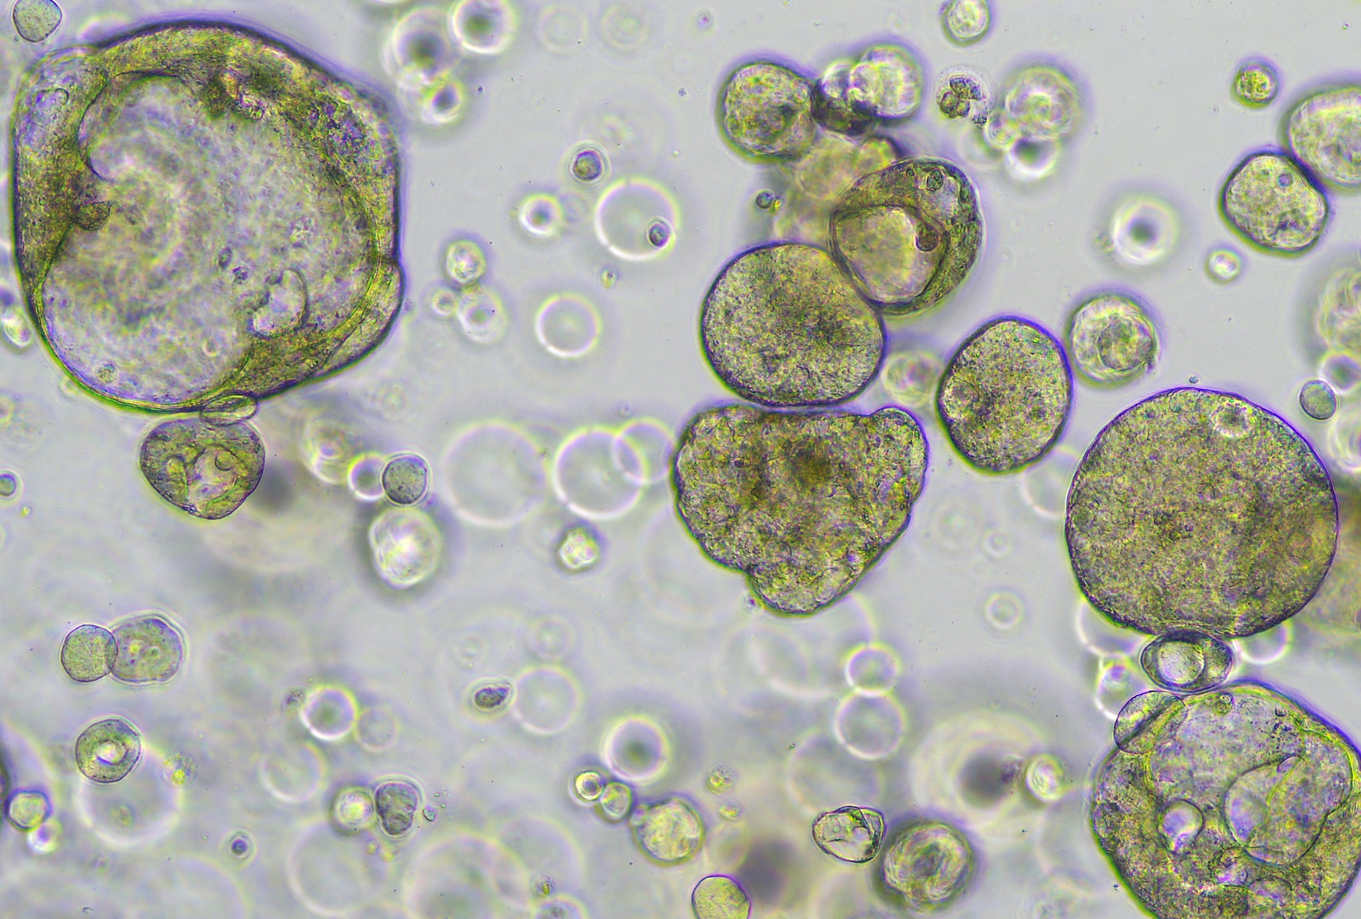
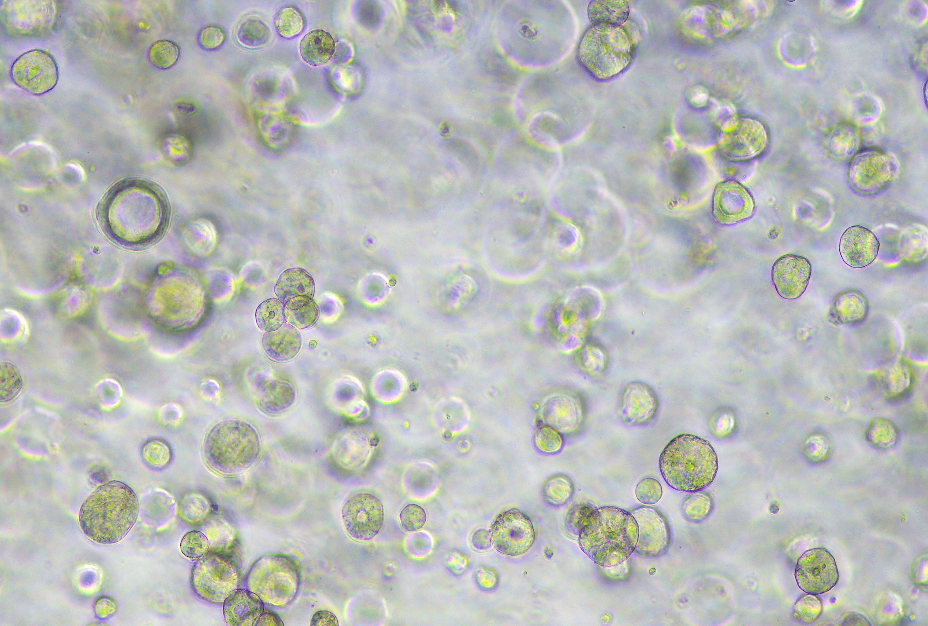
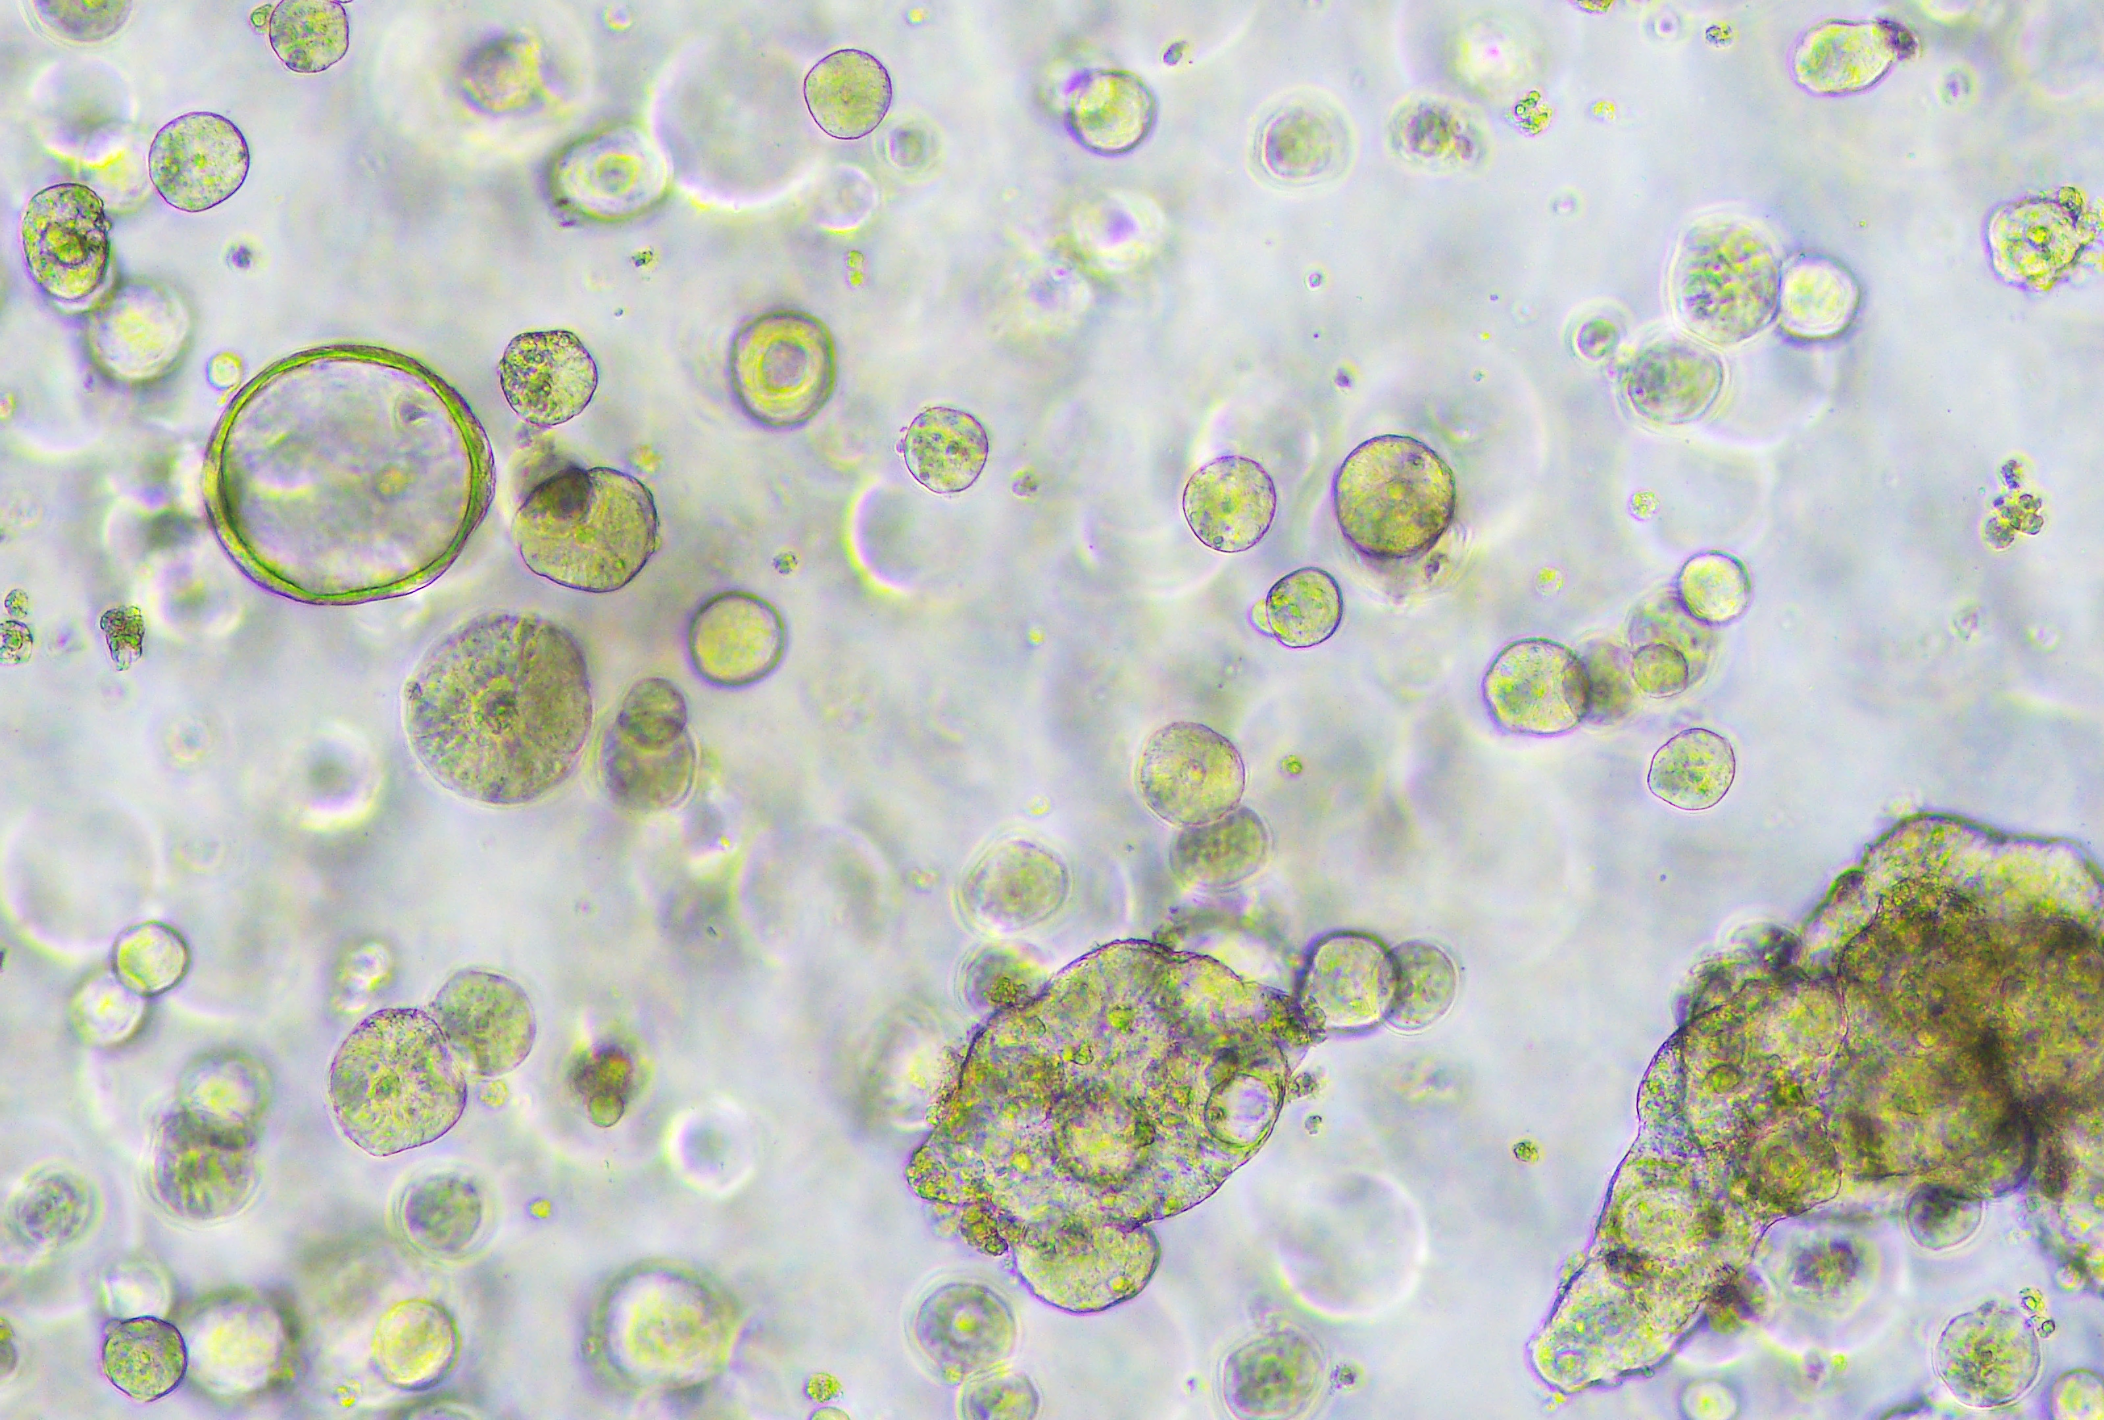
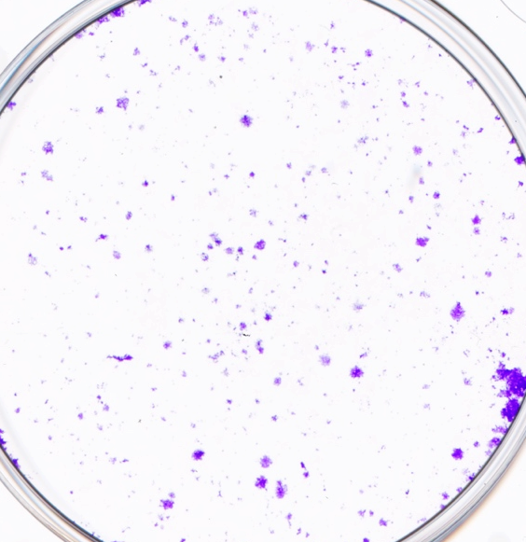
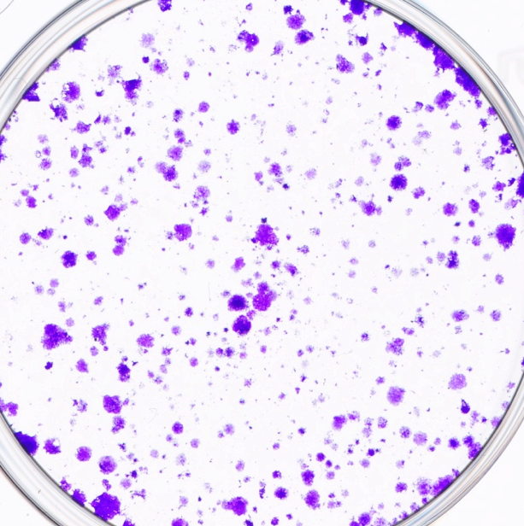
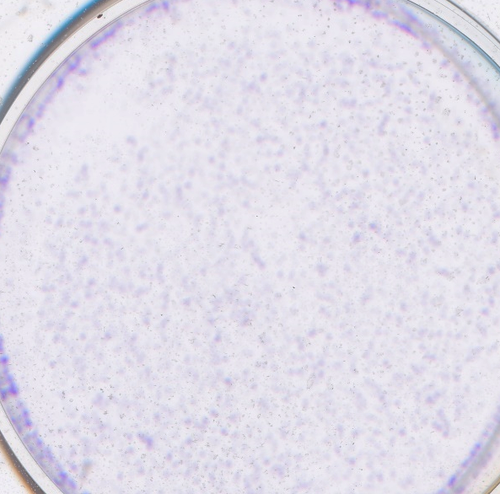
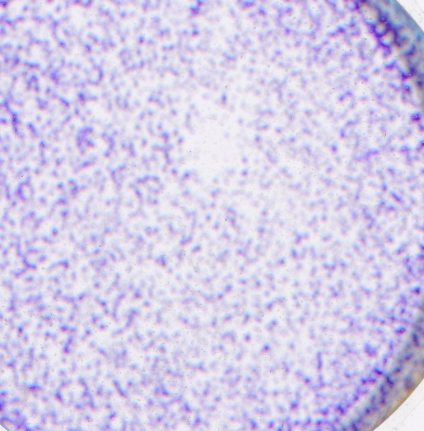
Figure 2
Fungi A can promote CRC .
A
B
**
CTRL
A.R Treated
**
Organoid 828
Colony formation
(% of control)
Colony formation
(% of control)
Organoid 816
CTRL
A.R
CTRL
A.R
CTRL
A.R
CTRL
A.R
**
Surface area (µm2)
Surface area (µm2)
CTRL
A.R
CTRL
A.R

